Slide 1
Campylobacter
Assist. Prof. Dr. Hussein ALNaji

Slide 2
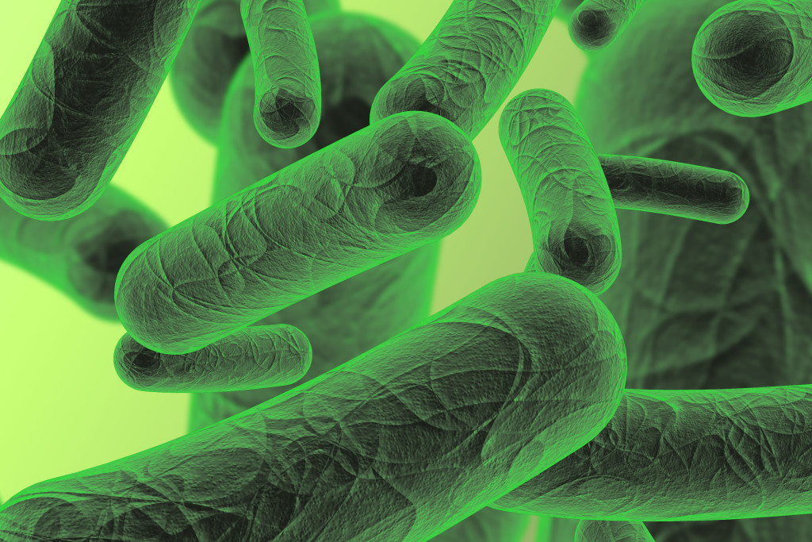
Globally, Campylobacter spp. is a common zoonotic pathogen of significant veterinary and public health concern. It is the causative agent of campylobacteriosis, a gastrointestinal disease that has been increasing in incidence over the last decade. Campylobacter spp. are ubiquitous; they are found in humans and many animal species, although some clonal complexes are more commonly associated with certain hosts. C. jejuni and C. coli can infect cattle, sheep, chickens, turkeys, dogs, cats, mink, ferrets, pigs, non-human primates and other species.

Slide 3
Transmission and spread
1- The main route of transmission is generally believed to be foodborne, via undercooked meat and meat products, as well as raw or contaminated milk..
2- Contaminated water or ice is also a source of infection.
3- Carcasses or meat are contaminated by Campylobacter from faeces during slaughtering.
4- Wild rodents and insects such as houseflies may be mechanical vectors.

Slide 5
Symptoms
1- The onset of disease symptoms usually occurs 2 to 5 days after infection with the bacteria, but can range from 1 to 10 days.
2- The most common clinical symptoms of Campylobacter infections include diarrhoea (frequently bloody), abdominal pain, fever, headache, nausea, and/or vomiting. The symptoms typically last 3 to 6 days.
3- Complications such as bacteraemia (presence of bacteria in the blood), hepatitis, pancreatitis (infections of liver and pancreas, respectively), Arthritis and neurological signs.

Slide 6
Diagnostic Tests
1- A presumptive diagnosis can be made by direct microscopic (e.g., darkfield) observation.
2-Definitive diagnosis is by culture and identification.
3-Feces or (rarely) blood cultures are used for diagnosis.
4- PCR-based techniques utilizing human stool enable rapid detection or culture confirmation.
5- A number of serologic assays have been developed, but most are not available for routine diagnostic use.

Slide 7
Prevention
1- Prevention is based on control measures at all stages of the food chain, from agricultural production on a farm, to processing, manufacturing and preparation of foods both commercially and domestically.
2- Good hygienic slaughtering practices reduce the contamination of carcasses by faeces.
3- Bactericidal treatment, such as heating (for example, cooking or pasteurization) or irradiation.
4- Sick animals, such as puppies, kittens, or livestock, should be kept away from children.

Slide 8
T H A N K Y O U

